Slide 1
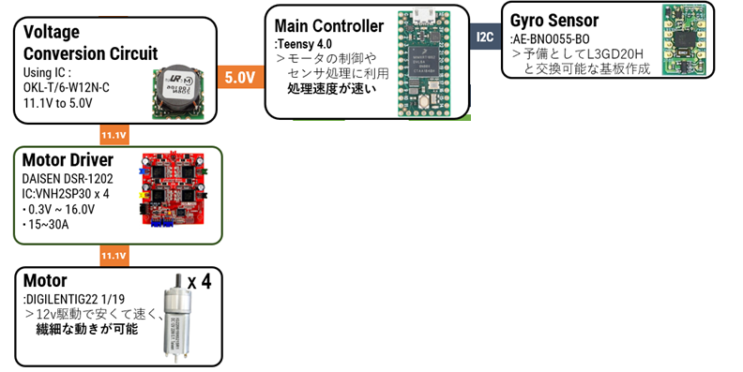
How do you use your processor to move your motors?
START
Get gyro data
Determine motor speed
END

Slide 2
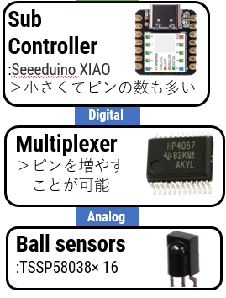
How do you find where the ball is? How do you read the data from the ball detection sensors or camera?
START
Get analog value
Vector composition
Calculate the ball angle
END

Slide 3
How does your algorithm work to catch the ball? Is there a difference between your robots in how they move towards the ball? Explain the differences.
Attacker
Goalkeeper
START
START
Get the angle of the ball
Line tracing
Moves according to the angle of the ball
Get the ball angle and the goal angle
Is the ball in the ball capture zone
Y
Kick the ball
Move along those lines
N
END
END

Slide 4
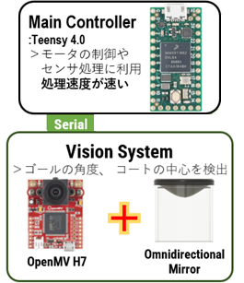
How does your robot find the lines to stay inside the field? What algorithms do you use to avoid going out of bounds?
START
Calculate the court angle
Did the line sensor react
N
Move as usual
Y
Move towards the center of the court
END

